Slide 1
Simulink Model Overview
TestAplysiaClass.m
Description: Example driver script that initializes variables and methods necessary for the Simulink model to run, configures the simulation and then calls the Simulink model.
Test.slx
Description: Simulink file containing a mixture of MATLAB function calls (setSensoryStates and Neural Control Blocks) and Simulink blocks
AplysiaSimulink.m
Description: Class that contains the initialization parameters for different signals, thresholds and distances, as well as methods to run the simulink file and plot results
I2_Hill_Type_Muscle_Model.m
Description: Class that initializes parameters for the I2 Hill Type Model
FeedingBehavior.m
Description: Enumeration class for feeding behavior: bite (1), swallow (2) and reject (3)

Slide 2
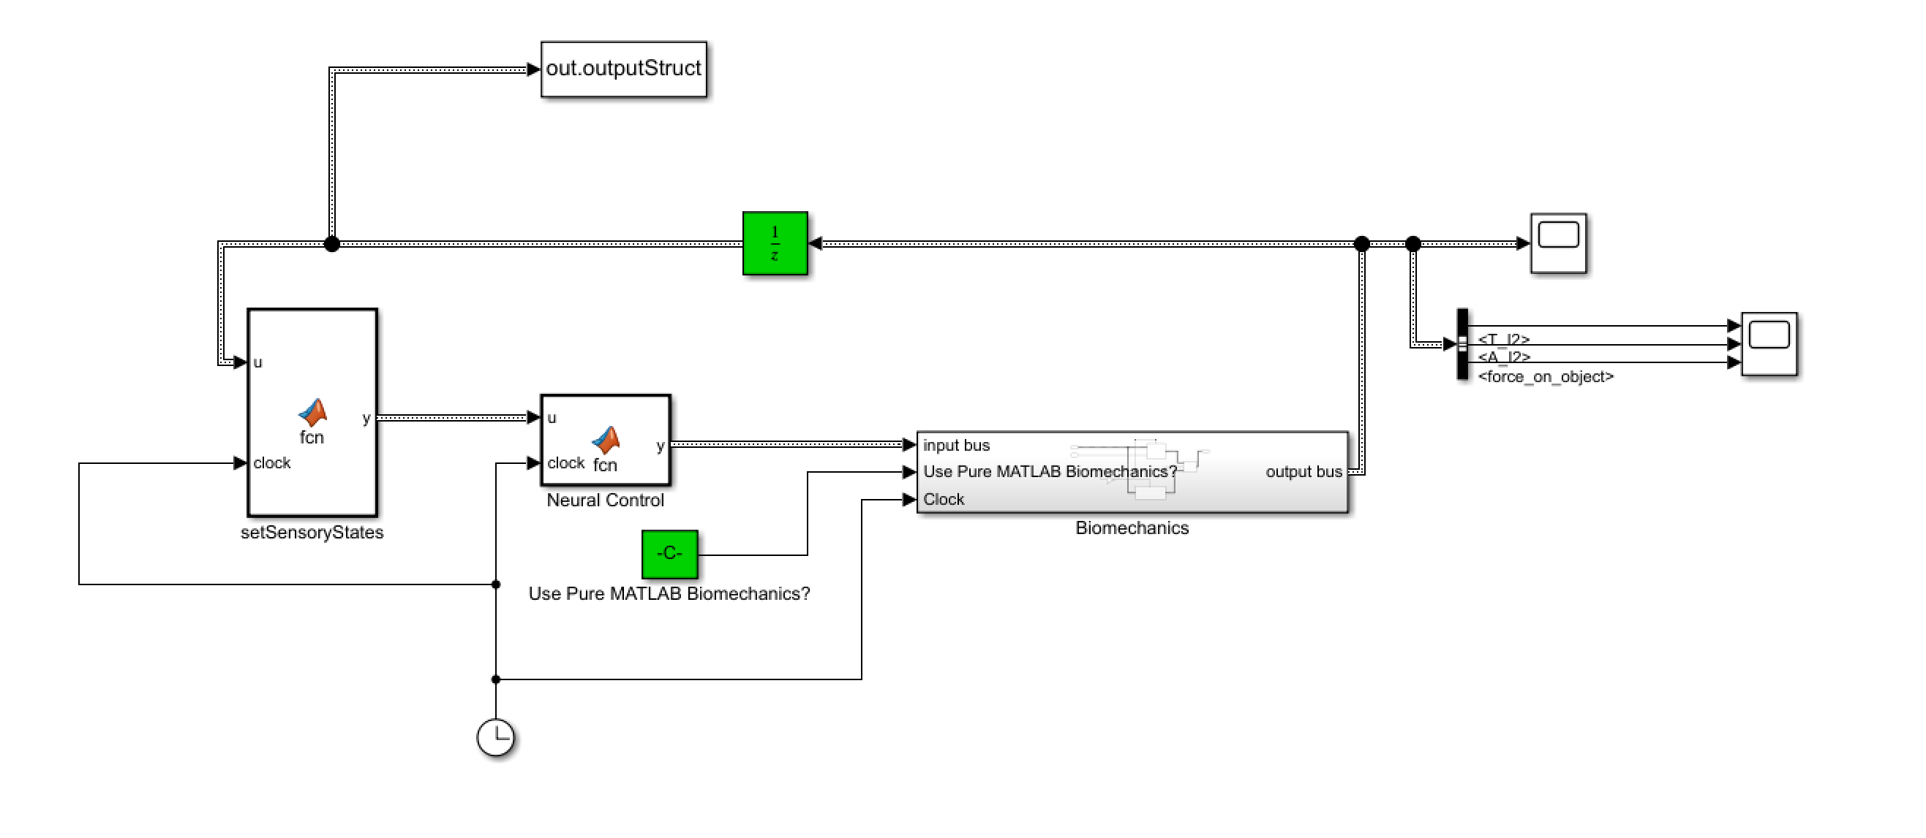
Simulink Overview
Output:
Time series data of positions, neural signals etc. exported to MATLAB workspace
Initial conditions and time step delay
Bus:
Transports grasper position, neural states etc. from one block to another
Biomechanics:
Contains the following equivalents of line 662-867 in ”AplysiaFeeding.m” of original Boolean MATLAB model:
Pure MATLAB function implementation (Biomechanics_pureMatlab.m)
Simulink block based implementation (Simulink Biomechanics). This is where the Yu I2 muscle model is integrated
Note:
To use the Pure MATLAB biomechanics, set USE_PURE_MATLAB_BIOMECHANICS to 1. 0 means use Simulink block based implementation
To use the Yu I2 Hill type muscle model, set variable USE_YU_I2_HILL_TYPE_MUSCLE_MODEL to 1.
setSensoryStates Block:
Equivalent to function setSensoryStates (line 871-937 in ”AplysiaFeeding.m” of original Boolean Matlab model)
Neural Control Block:
Neural signal generation and processing code (line 206-661 in ”AplysiaFeeding.m” of original Boolean Matlab model)

Slide 3
Yu Hill-type Muscle Model for I2

Slide 4
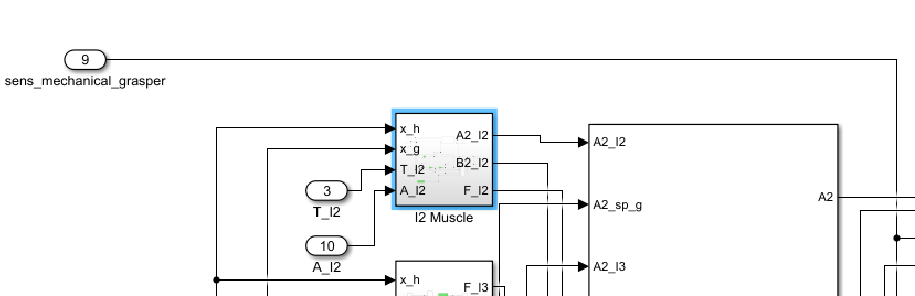
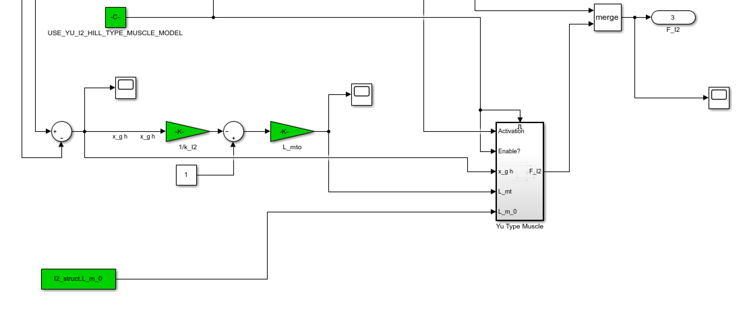
Yu Hill-type Muscle Model for the I2
Yu Hill-type muscle model
Length relationship between I2 muscle length and grasper position (to be improved)

Slide 5
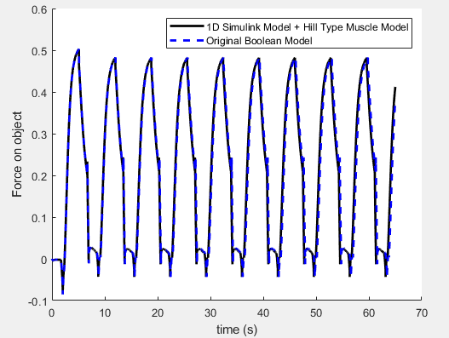
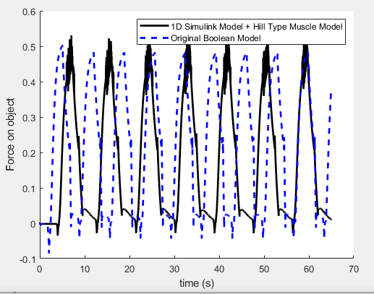
Yu Hill-type Muscle Model for the I2: Current Results (Swallowing)
Simulink model with original biomechanics vs. original Boolean Model implementation shows little difference in response
Simulink model with Yu Hill-type I2 model vs. original Boolean Model implementation. Note that there is additional high frequency noise and that the Yu Hill-type model grows progressively slower as the simulation evolves

Slide 6
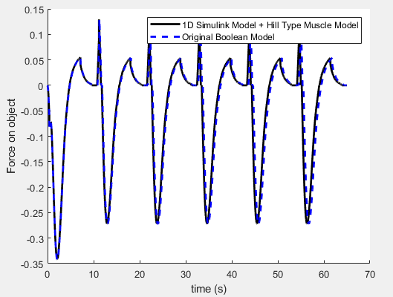
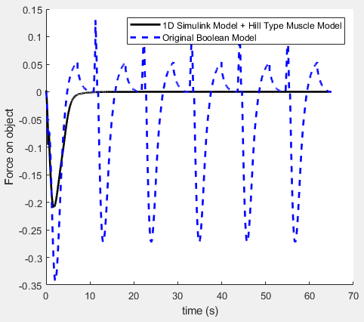
Yu Hill-type Muscle Model for the I2: Current Results (Rejection)
Simulink model with original biomechanics vs. original Boolean Model implementation shows little difference in response
Simulink model with Yu Hill-type I2 model vs. original Boolean Model implementation. Note that periodic behavior is not obtained. Currently investigating why

Slide 7
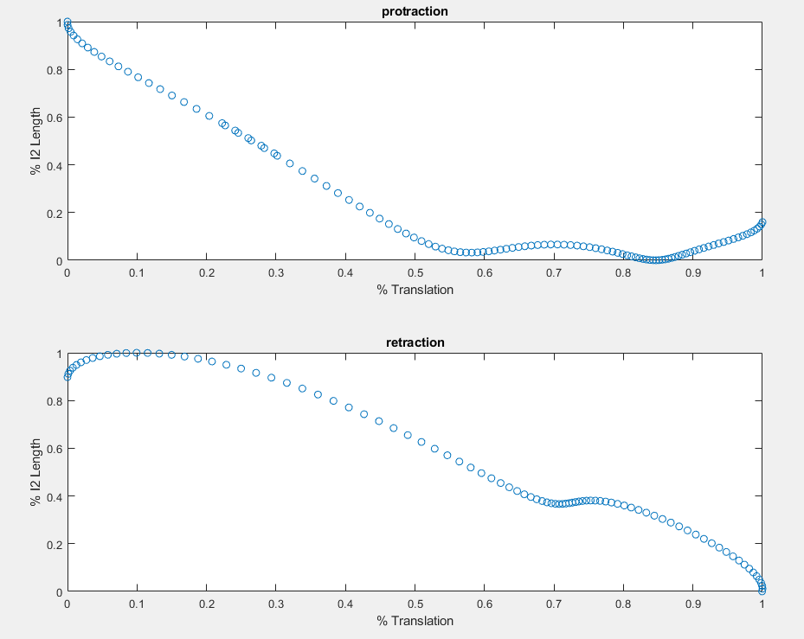
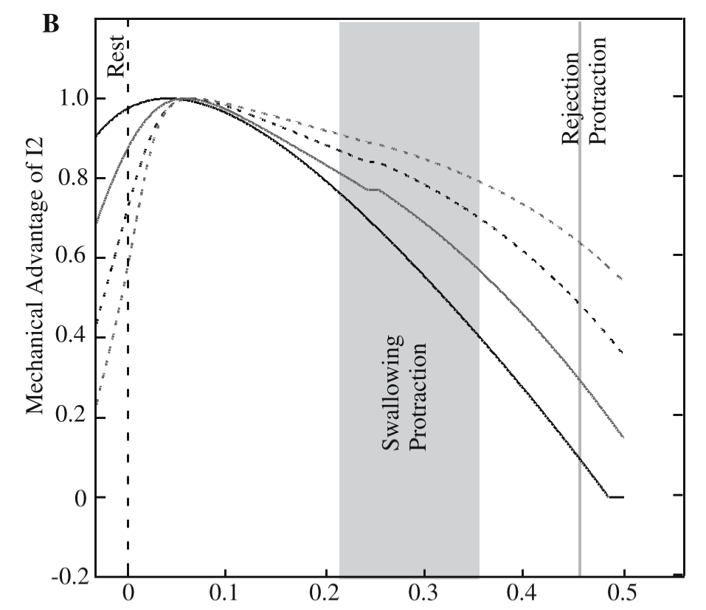
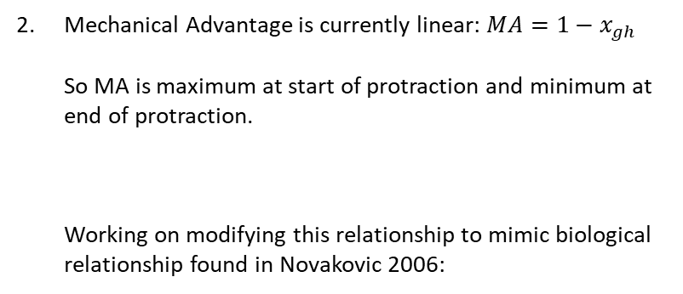
Yu Hill-type Muscle Model for the I2: Future Improvements
Current relationship between grasper position and I2 muscle length is linear, where maximum protraction results in least force and maximum retraction results in max force. Working on modifying this relationship to mimic biological relationship found in Neustadter 2002:
Mechanical Advantage is currently linear: $MA=1−x_{gh}$ So MA is maximum at start of protraction and minimum at end of protraction. Working on modifying this relationship to mimic biological relationship found in Novakovic 2006:
Odontophore Displacements (in Buccal Mass Lengths)

Slide 8
File Overviews

Slide 9
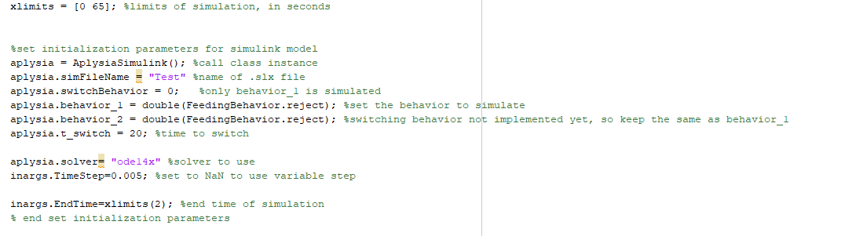
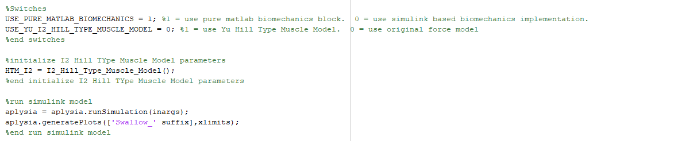
TestAplysiaClass.m Overview
Begin initialization of variables
Set as the same behavior
Timestep in seconds. <0.005 s to minimize error between Simulink implementation and original MATLAB implementation
Switch for whether to use pure MATLAB or simulink based biomechanics implementations
In Simulink Model, use Yu Hill Type Muscle Model for I2, or the original Boolean model of I2
Run Simulation and generate plots

Slide 10
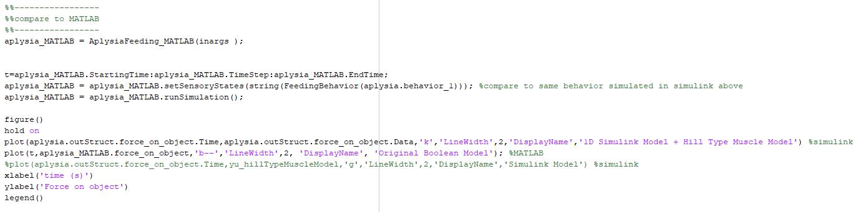
TestAplysiaClass.m Overview (con’t)
Set as the same behavior
Run original Boolean Model Implementation
Plot force on object for both original Boolean implementation and for Simulink implementation

Slide 11
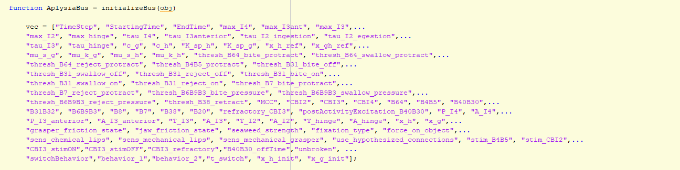
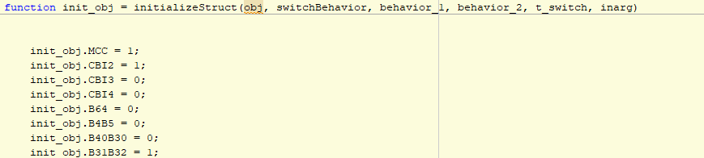
AplysiaSimulink.m Overview
If a new element needs to be added for initialization e.g. B99 = 1:
Locate the array “vec” in the “initializeBus” function, and add the name of the variable (in double quotation marks) to the list. E.g. “B99”
In the “initializeBus” function, add the variable and initial value as follows: init_obj.B99 = 1; Note: assigned value must be a number

